Slide 1
University Of Basrah Collage Of Nursing
Lecture 1
The Microscope
by
Assistant Lecture
Zahraa Mahmoud Hussain

Slide 2
The Microscope It is a scientific equipment that magnifies very small objects that is not visible to the naked eye to an extent where it can be seen clearly.
Microscope Micro= Small Scope= To look

Slide 3
Uses Of Microscope
The microscope is one of the most commonly used instruments in the medical and life sciences colleges, and in clinical laboratories.
» Physiology: in the study of morphology of blood cells and in counting their numbers.
» Histology: histopathology and tissue analysis.
» Microbiology: to study various type of bacteria, parasite and fungi.

Slide 4
The Objective
1.Explain the different parts of the microscope and its functions.
2. Explain how to use a microscope.
3. Explain the types of microscopes.
4. Explain how to maintain the microscope.

Slide 5
Common Type Of Microscope
1.Simple Microscope: has one optical lens.
2. Compound Microscope: it has two lenses objectives and ocular, it is used visible light as source of illumination.
3. Dark-field microscope: it appeared the sample bright and the field dark.
4. Electron microscope: it used flow of electron insteated of light.
5. Fluorescence Microscope: use fluorescent day to stain the sample.

Slide 6
Part Of Compound Microscope
A: The Supporting System
1.Arm or handle: carry the microscope and supports lenses.
2. Base: It is a heavy metallic part which supports the microscope on the worktable to provide maximum stability.
3. Body tube : the body tube is the part through which light passes to the eyepiece, thus conducting the image to the eye of the observer.
4. The Stage: It is a square platform with an aperture in its center, the slide is placed on it and centered over the aperture for viewing.

Slide 7
Part Of Compound Microscope
B: The Focusing System
The focusing system consists of coarse and fine adjustment screw-heads. It is employed for raising or lowering the optical system.
1.Course Focusing Knob (Coarse adjustment screw):The coarse adjustment moves the optical system up or down rapidly through a large distance.
2. Fine Focusing Knob (Fine adjustment screw): The fine adjustment works in the same way, it used to move the tube through a small distance.

Slide 8
Part Of Compound Microscope
C. The Optical System
1. Body tube : the body tube is the part through which light passes to the eyepiece, thus conducting the image to the eye of the observer.
2. The eyepiece.
3. The nosepiece.
4. Numerical Aperture or Objective Lens: the closest to the specimen.
5. Ocular Lens: the closest to the eye.

Slide 9
Part Of Compound Microscope
C. The illumination System
Source of light.
The Mirror.
3. The Condenser.
4. Numerical Aperture or Objective Lens: the closest to the specimen.
5. Ocular Lens: the closest to the eye.

Slide 10
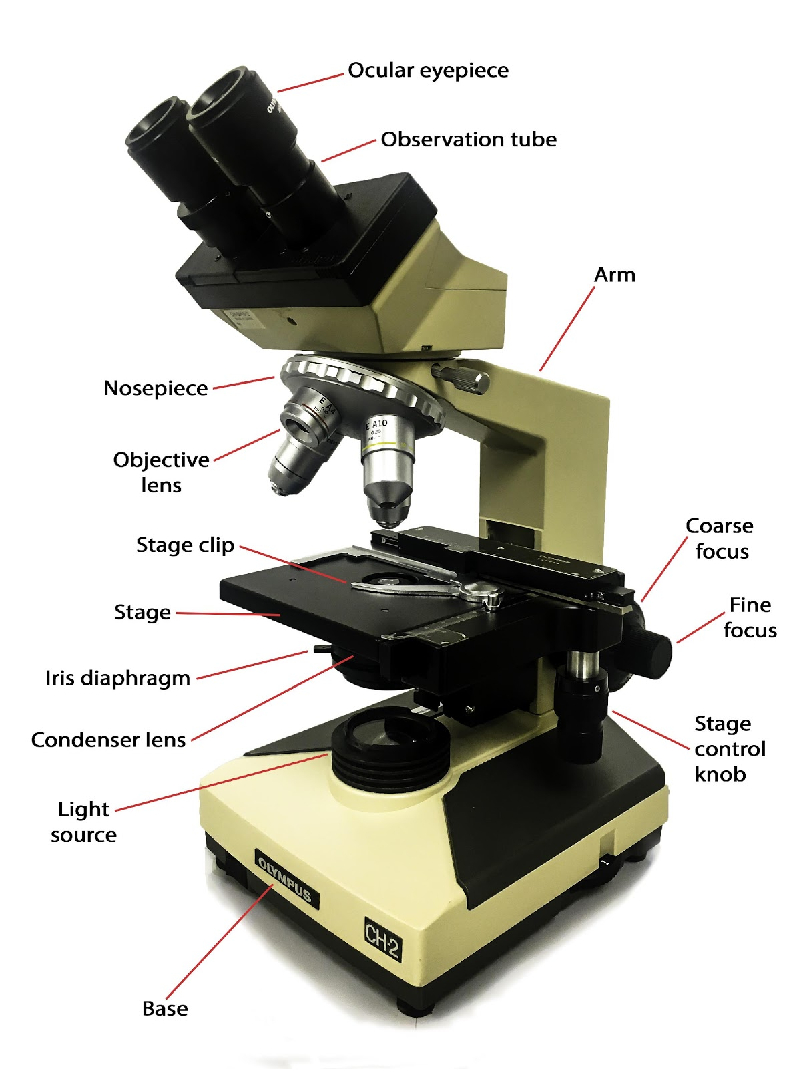
This Photo by Unknown Author is licensed under CC BY-SA-NC

Slide 11
The Routine Care Of Microscope
1. Do not touch the lenses with your fingers.
2. Cleaning the microscope, never leave cedar wood oil on the oil lens.
4. Cover the microscope with the plastic cover after use.

Slide 12
Notices about cleaning the microscope
Cleaning the microscope. Never leave cedar wood oil on the Ol lens, because it may seep into the body of the objective and damage the lens per- manently. Dried oil is difficult to remove. Remove oil with lens paper, then xylene to clean the lens.
Lenses should be cleaned with xylol and wiped with lens paper or cigarette rolling paper. They should not be cleaned with handkerchiefs or paper tissuebecause that will scratch the lenses and make them unusable.

Slide 13
Thank you for listening

